Slide 1
Great Open Source Compliance For Everyone
https://www.openchainproject.org

Slide 2
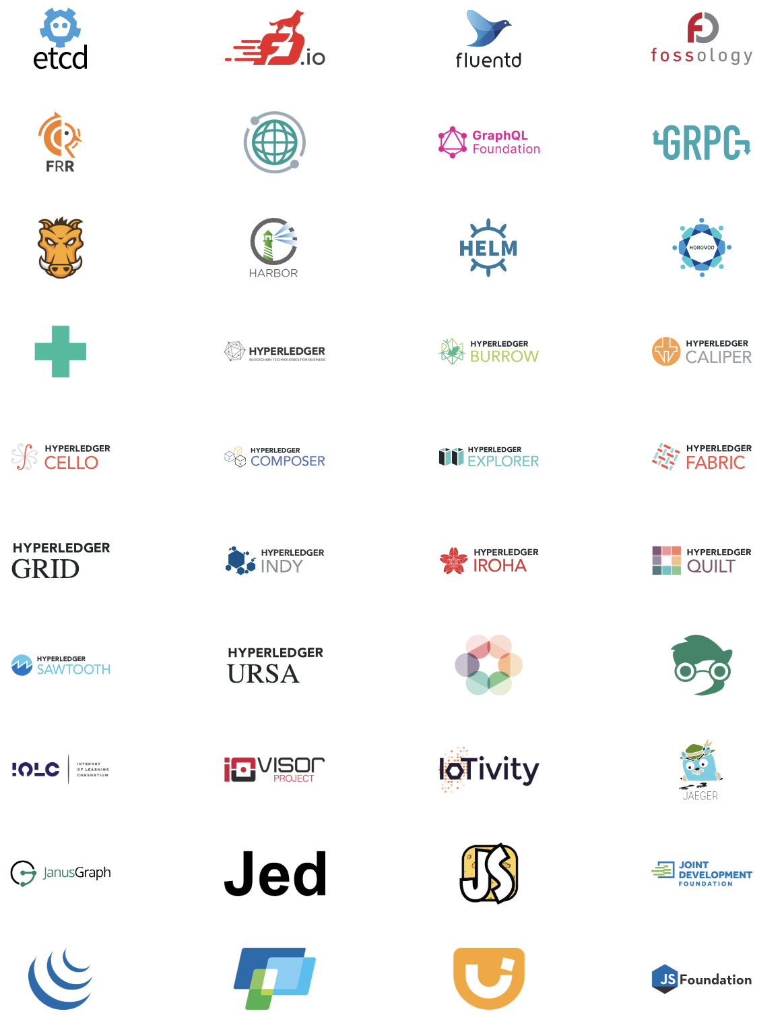
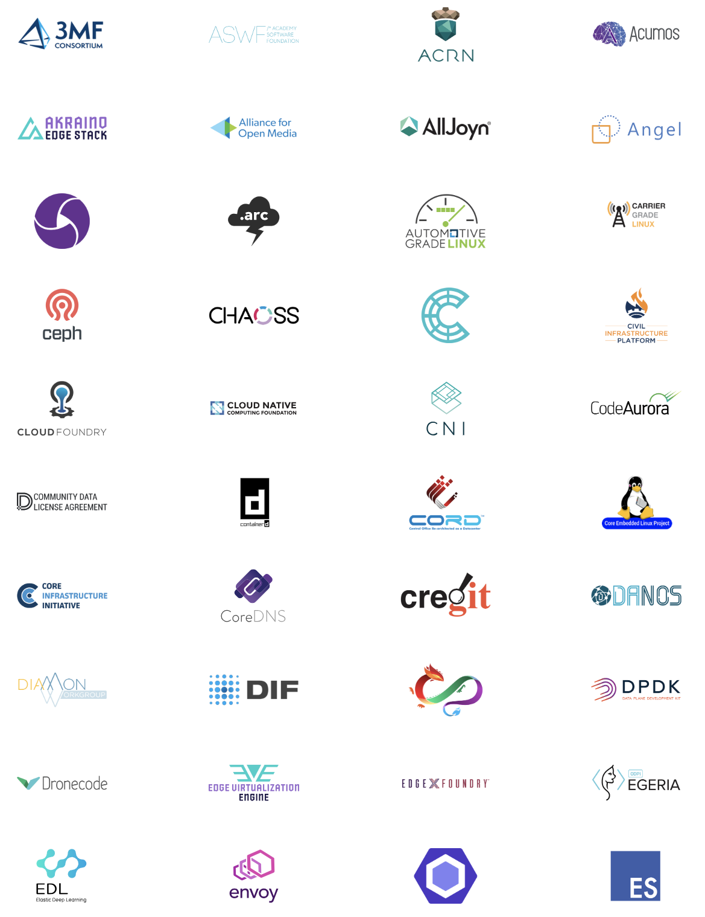
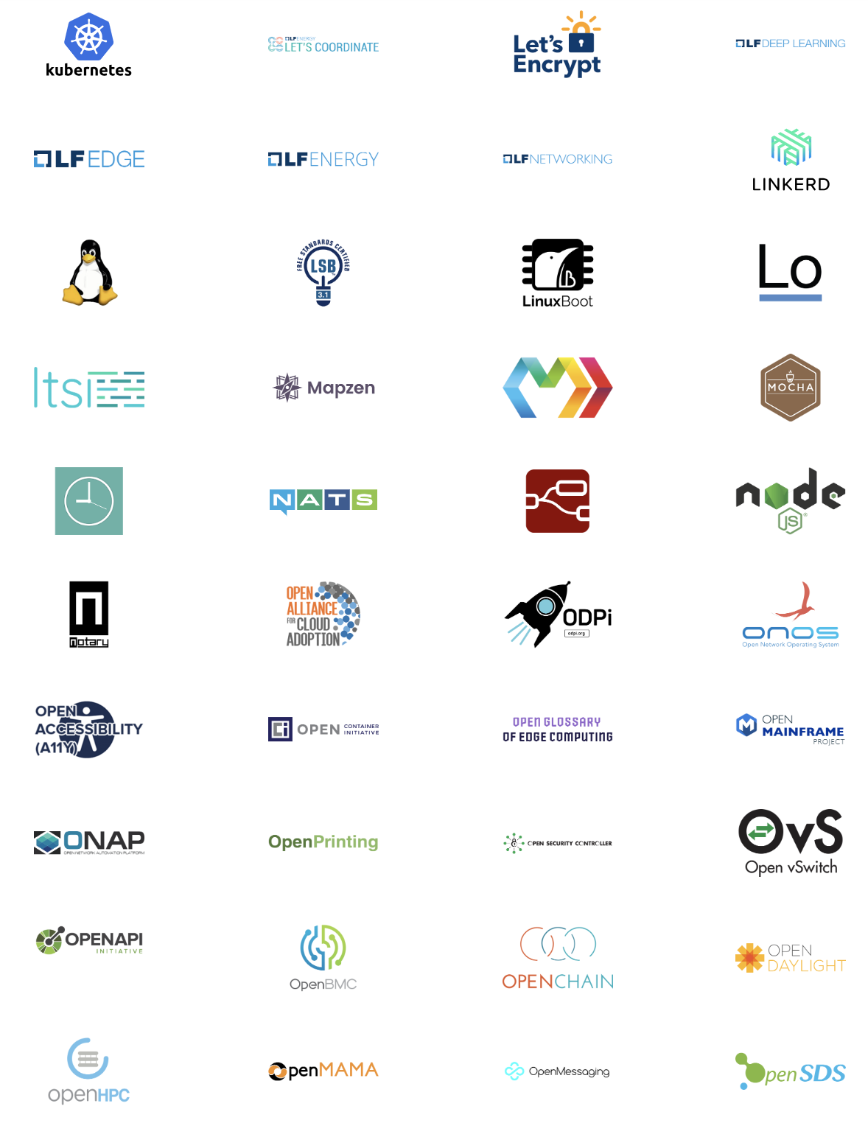
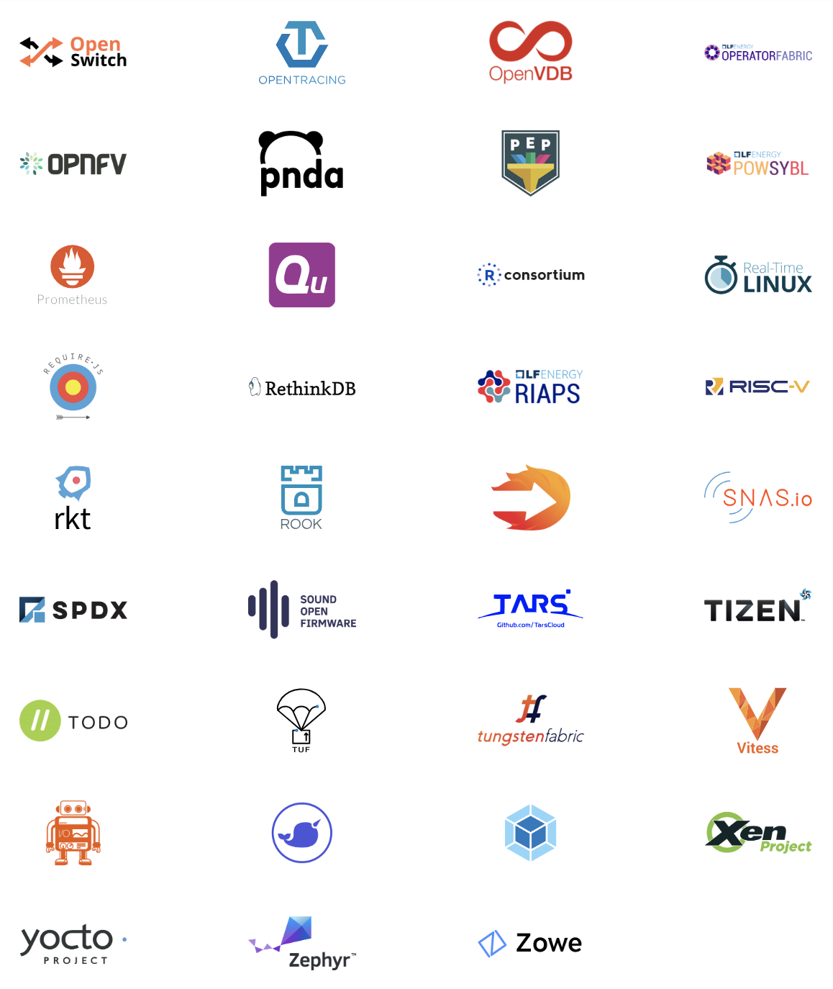
Notes:
Here is a quick tour of Linux Foundation projects. We are not going to dwell on any single project. We are looking at scale.

Slide 3
Compliance – A gateway to access
Notes:
Open source license compliance is a gateway to accessing projects like these. It is gateway to 16 billion dollars of code, platforms that can accelerate any market.

Slide 4
How do I trust my open source supply chain?
Notes:
Compliance is core to effective strategic engagement with open source technology. It is very important that we can contextualize this effectively for our supply chains.

Slide 5
The OpenChain Project defines the key requirements for a quality compliance program.
Notes:
The most important thing is that the OpenChain Specification defines the requirements for a quality compliance program.

Slide 6
OpenChain is a simple, effective standard for organizations of all sizes in all markets.
Notes:
This definition is kept as simple and as broadly applicable as possible to ensure global accessibility.

Slide 7
OpenChain Defines Inflection Points
upstream
downstream
inbound
Training
Policy
outbound
Process
Notes:
It defines the big picture, showing the inflection points where a company should have processes, policies or training.

Slide 8
Companies have the flexibility to decide the content of each specific process, policies and training.
Notes:
The OpenChain Specification confirms a company has open source processes, policies and training. Companies have the flexibility to decide the content of each specific process, policies and training.

Slide 9
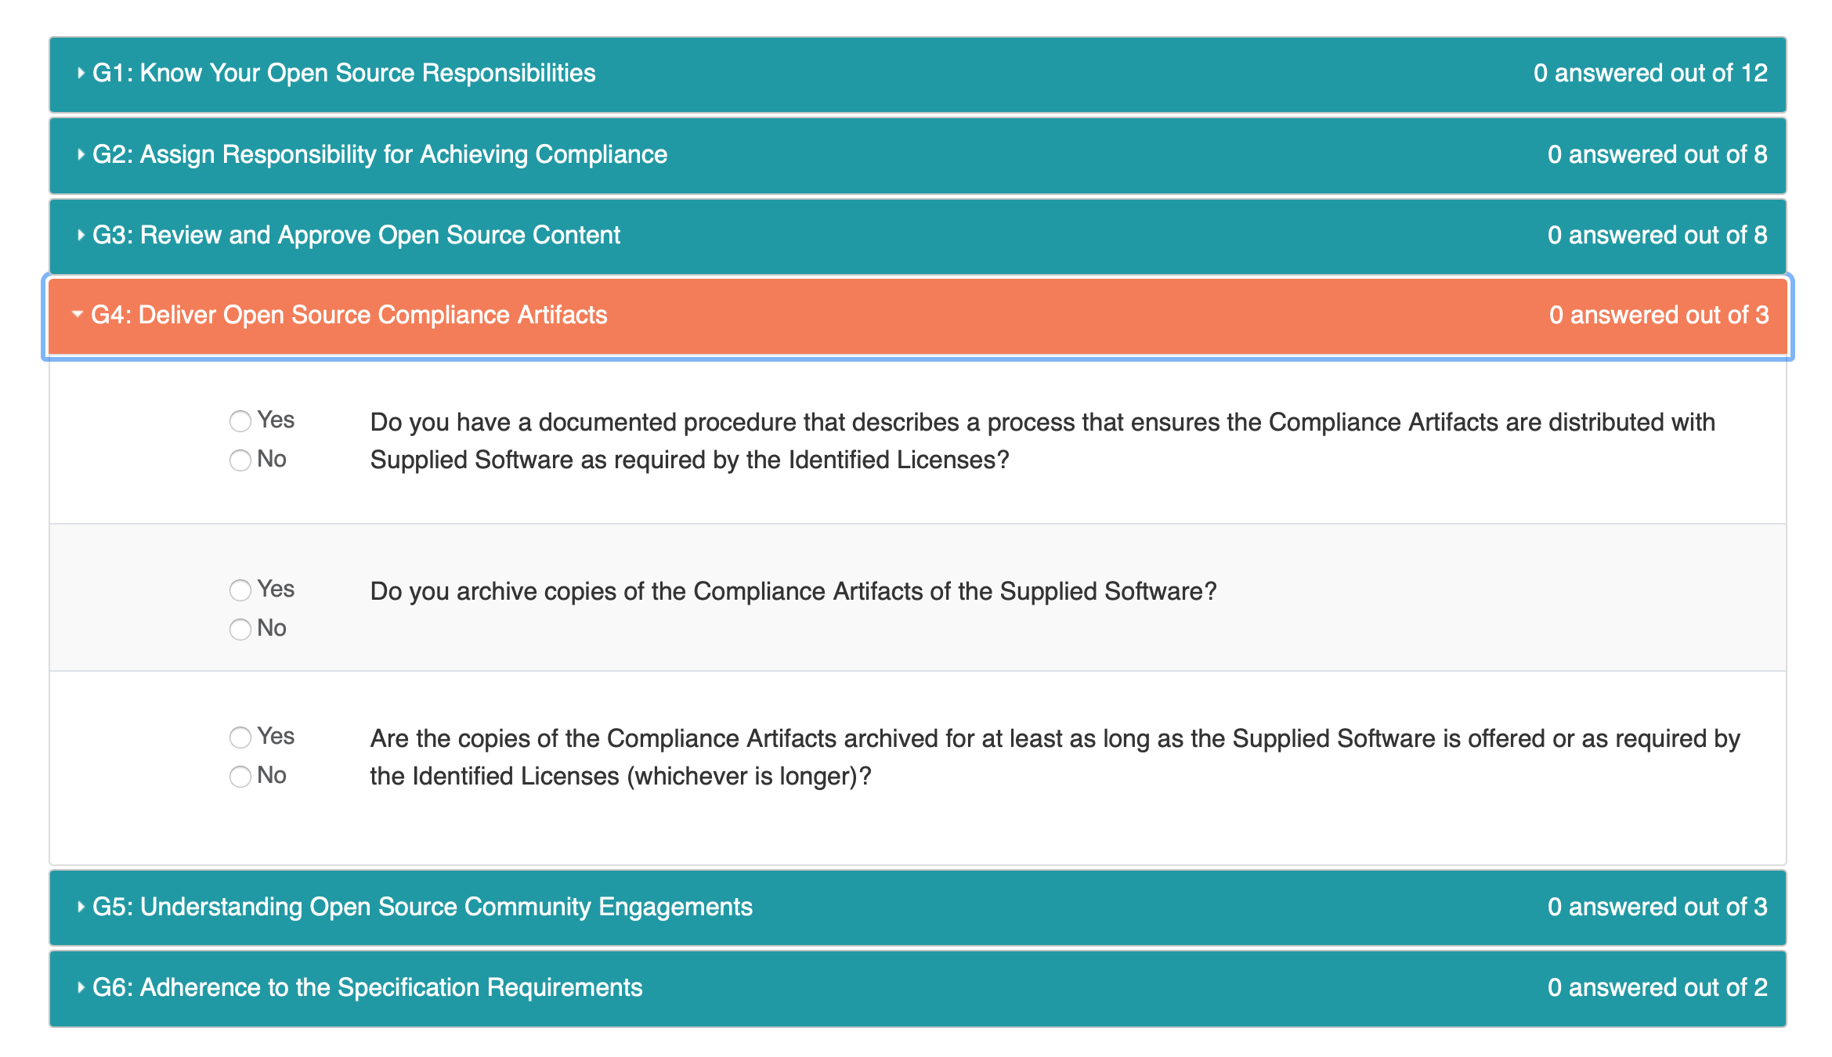
Our Online Self-Certification Questionnaire
Notes:
Another great announcement today related to conformance. We have a free self-certification web app and – as of today – we are announcing a huge revamp. The updated web app aligns with the user experience in sister projects, and provides a responsive interface for computers, tablets and mobile phones.

Slide 10
If a company can answer “Yes” to each question they are OpenChain Conformant.
Notes:
The exciting thing is how easy this is. If a company can answer Yes to each question they are OpenChain Conformant. This is a process companies can go through at their own pace and in private on the online Web App. Their conformance is only made public after they have passed the questionnaire and finalize their self-certification.

Slide 11

Notes:
There are a number of companies with a publicly announced OpenChain Conformant program. These companies come from a wide range of industries and represent a wide range of company sizes. Of course, there are many more undergoing OpenChain Conformance or without a publicly announced program.

Slide 12
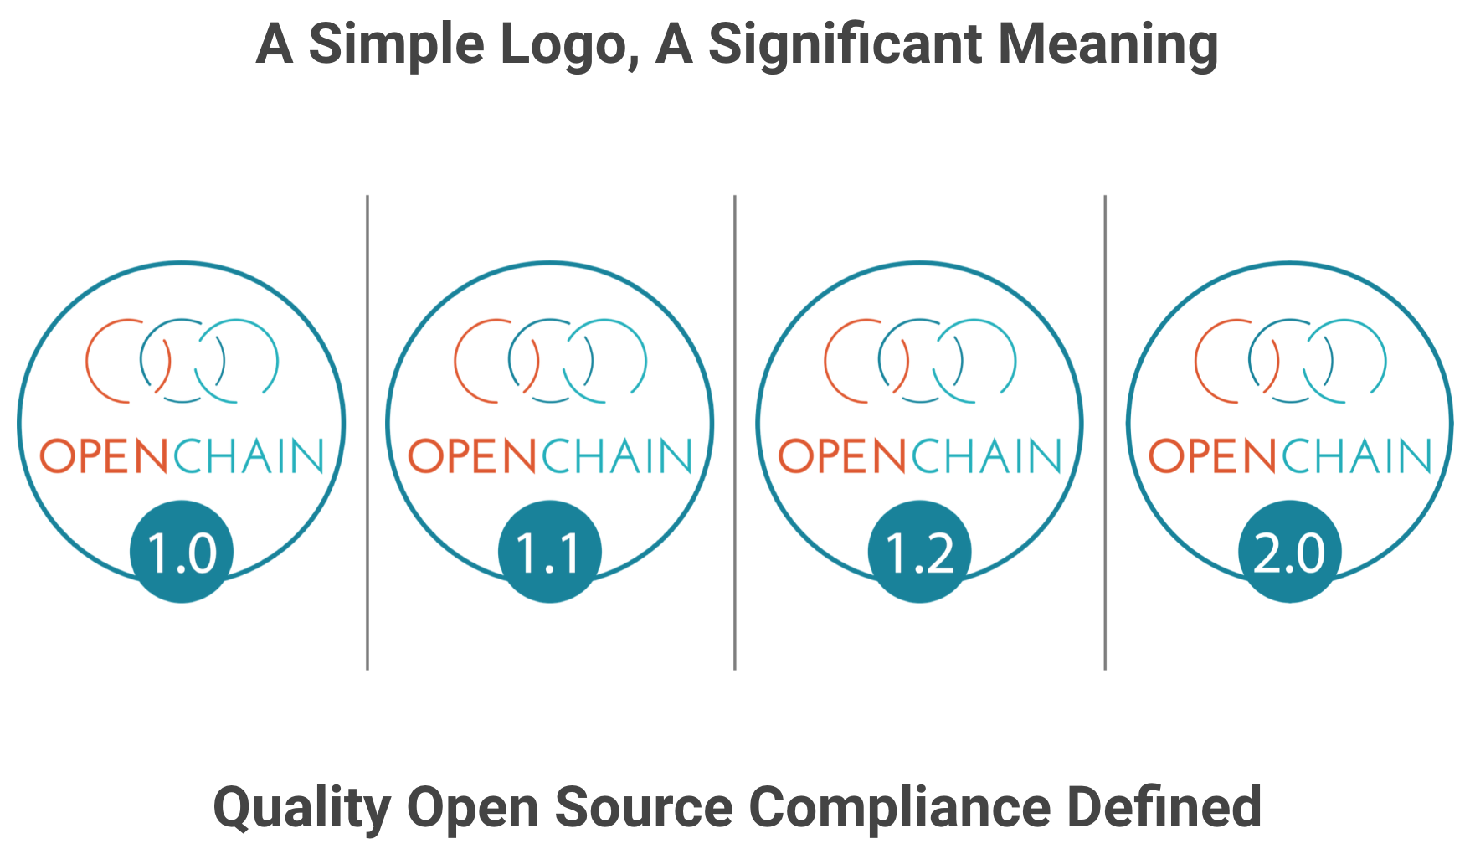
Notes:
Companies that meet the OpenChain Specification requirements can use a badge to identify their OpenChain Conformant program and the products that went through this program.

Slide 13
The OpenChain Project provides comprehensive and free reference material to help with conformance.
Notes:
To support this journey – especially around filling in the gaps identified when going through the OpenChain Conformance process – companies can use the library of material in the OpenChain Curriculum.

Slide 14
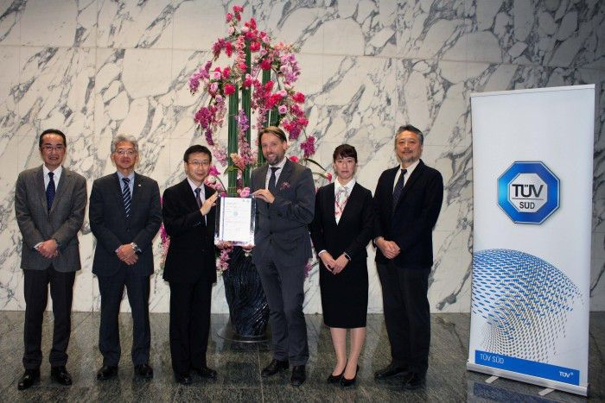
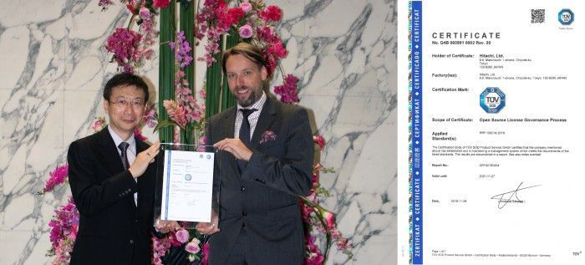
Audited Certification is an Option
Notes:
We have seen the energy around the project emerge in interesting and useful new ways. For example, a German certification authority called TUV Sud has recently started to offer an open source compliance certification based on OpenChain. This is useful for areas such as automotive where TUV Sud is synonymous with quality checks by a third party.

Slide 15
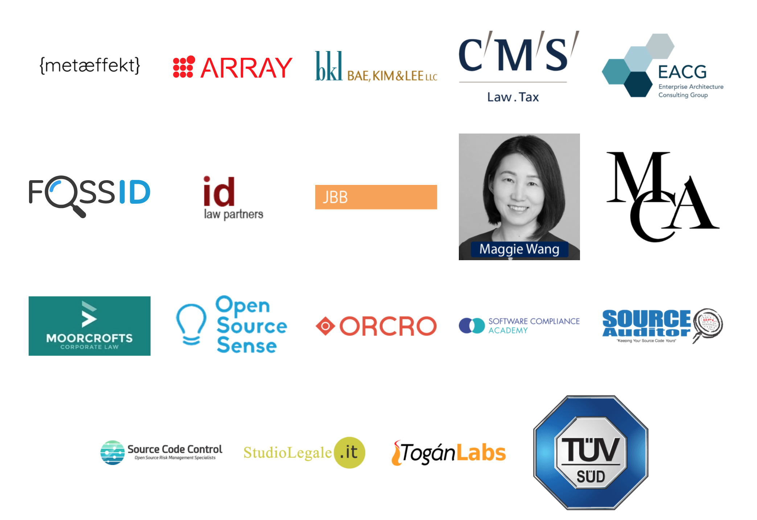
Partner Program – Participants
Notes:
The partner eco-system has seen healthy growth and offers assistance across three continents, with a primary focus at this juncture on legal support, but also including educators, consultants and vendors.

Slide 16
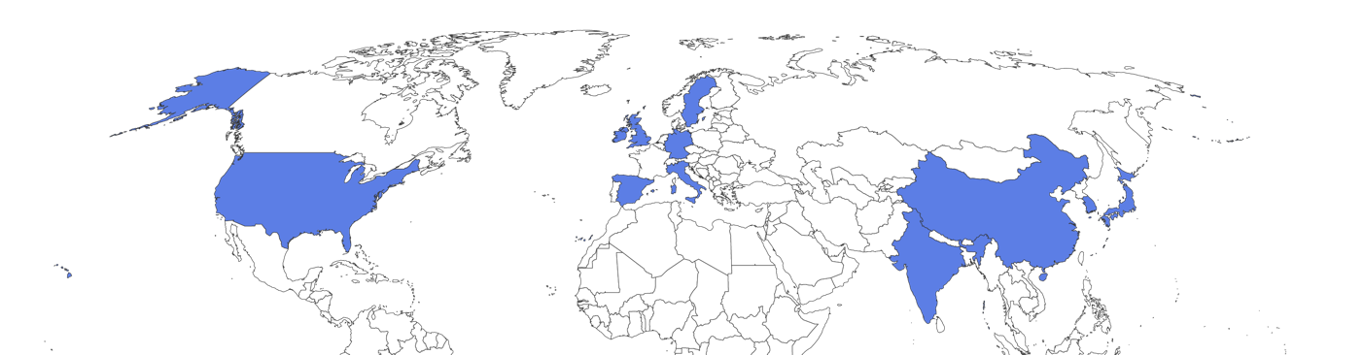
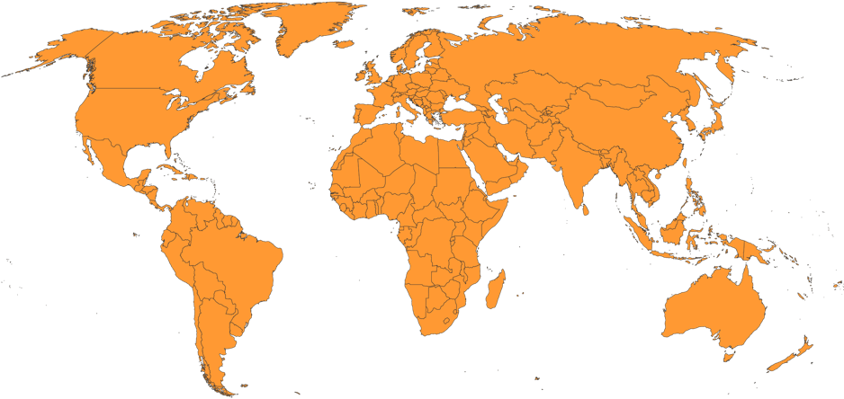
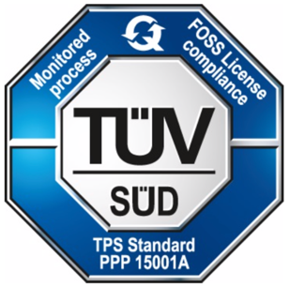
Partner Program – Geographic Coverage
Notes:
We have substantial and growing geographic coverage for the partner program. It now covers a significant number of strategic geographic locations, including the United States, China, South Korea, India, Japan, the UK, Germany, Italy, Spain, Sweden and Ireland.
Our third-party certification offering from TUV SUD is global.

Slide 17
OpenChain is run by user companies for user companies.
Notes:
The most important point about how OpenChain is run related to who is running it. The project is run by user companies for user company. Our partner eco-system is adjacent to this and always in service to this.

Slide 18
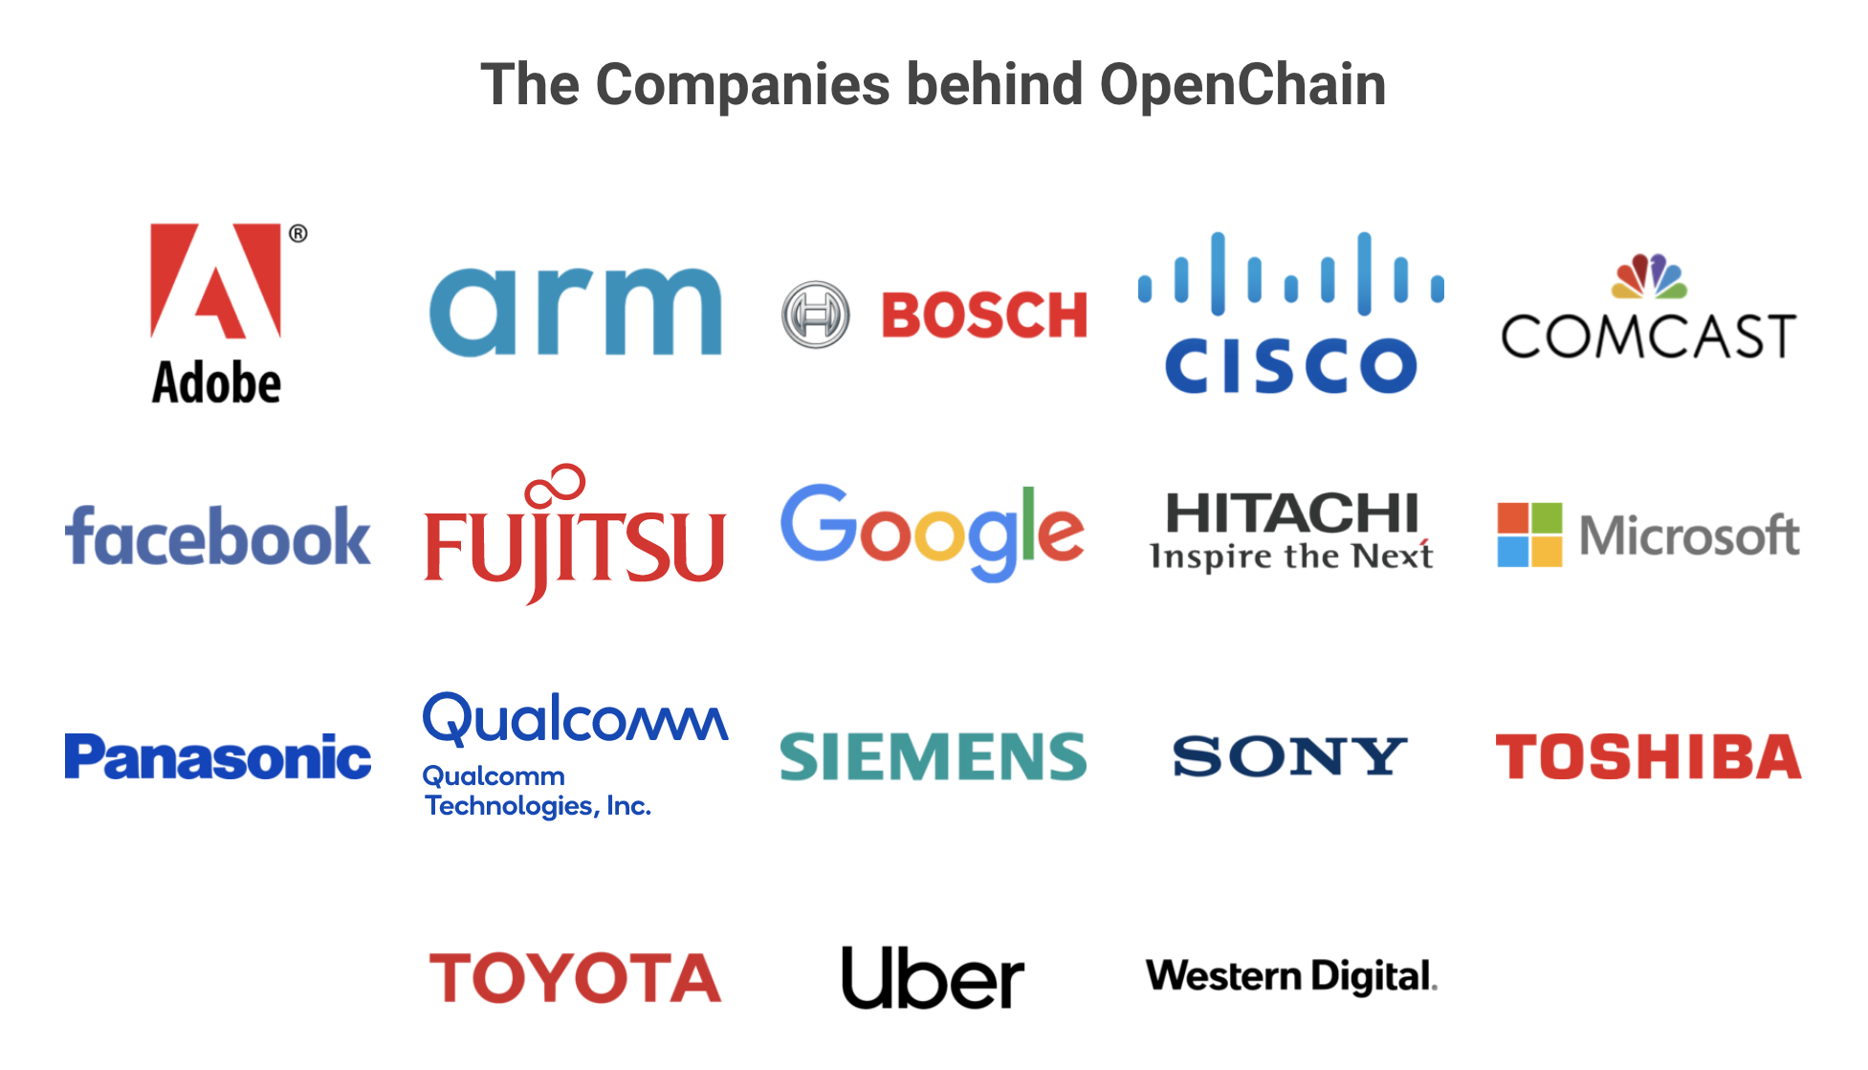
Overview of Project Status
Notes:
Here are the current Platinum Member companies in the OpenChain Project. As you can see, they are diverse, with Adobe standing shoulder to shoulder with Toyota in establishing this standard for open source compliance.

Slide 19

Overview of Project Status – Updated Website
Notes:
The individuals involved in our community are diverse. You can see here that the leads of our various work teams are from areas of the OpenChain community outside of the Platinum Members. We regard this diversity as a great strength in the project.

Slide 20
Work Teams supporting OpenChain:
Specification - Chaired by Mark Gisi (Wind River)
Conformance - Chaired by Miriam Ballhausen (SCA)
Curriculum - Chaired by Alexios Zavras (Intel)
Onboarding - Chaired by Nathan Kumagai (Qualcomm)
Notes:
The community is very inclusive and all of our day to day work is done via work teams that meet via phone twice a month. We do a lot of our work on these calls – where we publish slides and minutes – and we also do a lot of work on our mailing lists. Everyone is welcome to both. Indeed, we are actively seeking knowledge and contributors from all over the world. We are building a global standard and we want it to have a comprehensive global perspective.

Slide 21
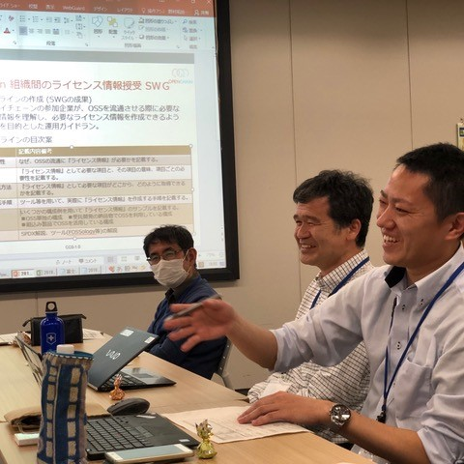
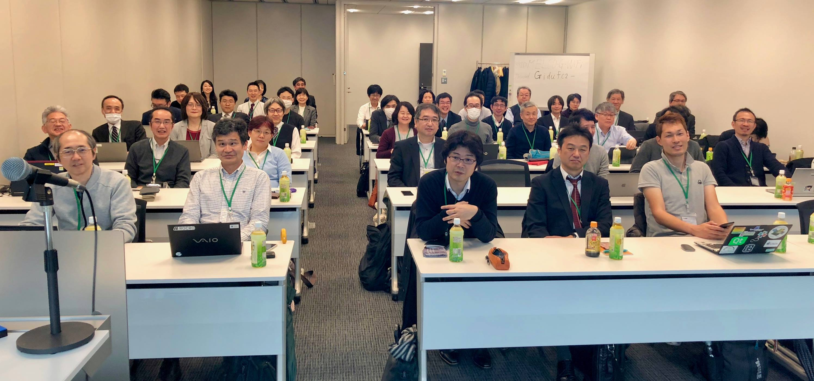
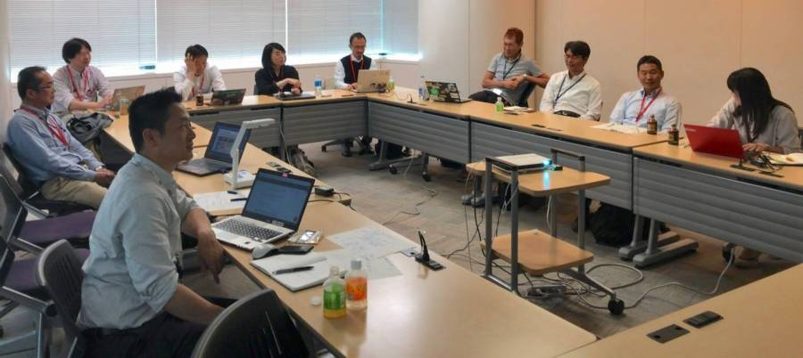

OpenChain in Japan
Notes:
A great example of the global OpenChain community can be found in Japan. This is our most active country-based work team, with bi-monthly meetings, and with 7 sub-groups currently working on specific items like supplier education and tooling automation.

Slide 22
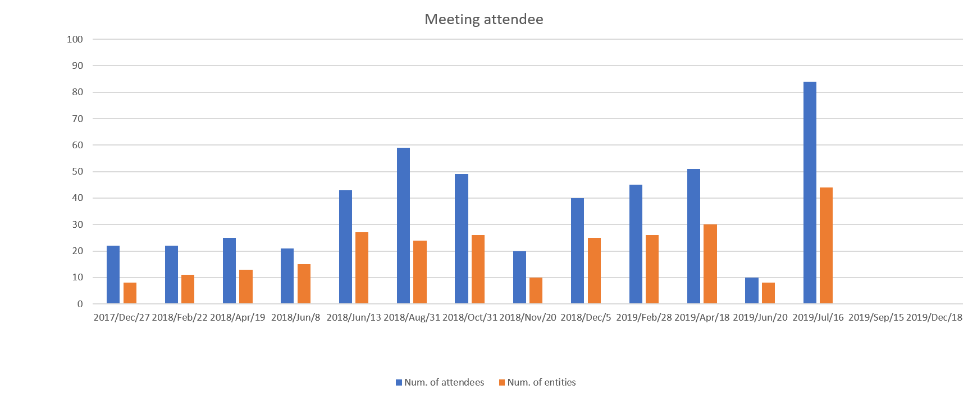
OpenChain in Japan
Notes:
The OpenChain Japan Work Group meetings are well-attended. The two dips in this chart show ad hoc meetings quickly assembled to discuss a specific topic. In general we see about 25 companies represented by about 45 individuals at the meetings.

Slide 23
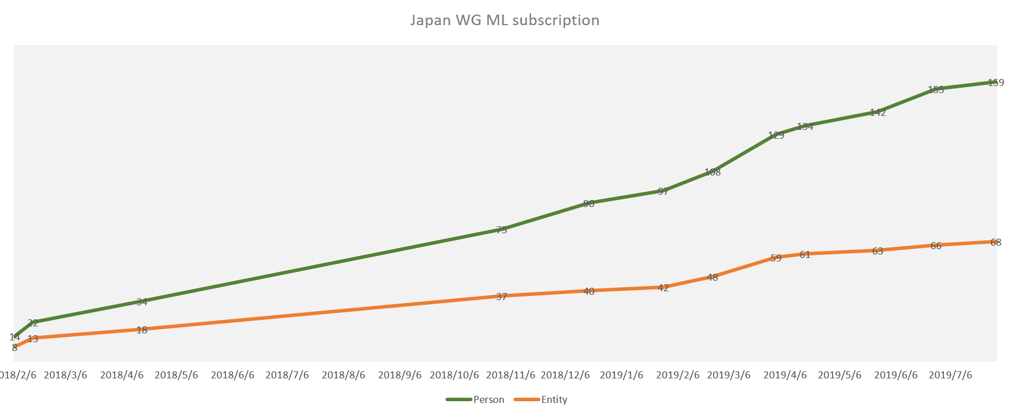
OpenChain in Japan
Notes:
The OpenChain Japan Work Group mailing list is larger, with constant growth since inception, and now containing almost 70 companies and over 160 individuals.

Slide 24
OpenChain in ISO
The OpenChain Project is preparing to submit the current OpenChain Specification 2.0 to the ISO Fast Track process via the Publicly Available Specification (PAS) approach in Joint Technical Committee 1 (JTC-1).
This process is being managed by our staff in collaboration with Platinum Member companies like Microsoft.
Notes:
The OpenChain Project is preparing to submit the current OpenChain Specification 2.0 to the ISO Fast Track process via the Publicly Available Specification (PAS) approach in Joint Technical Committee 1 (JTC-1).
This process is being managed by our staff in collaboration with Platinum Member companies like Microsoft.

Slide 25
OpenChain in ISO
We expect the OpenChain Specification 2.0 (reformatted slightly for ISO) to become a formal standard in the 1st half of 2020.
As a side note, TUV Sud have committed to collaboration to align their OpenChain-based standard (TPS PPP 15001A) with the OpenChain ISO standard to ensure a single approach for the market.
Notes:
We expect the OpenChain Specification 2.0 (reformatted slightly for ISO) to become a formal standard in the 1st half of 2020.
As a side note, TUV Sud have committed to collaboration to align their OpenChain-based standard (TPS PPP 15001A) with the OpenChain ISO standard to ensure a single approach for the market.

Slide 26
OpenChain in Automotive
The Automotive Work Group has started in July with these goals:
Share information to support best practices in the industry
Build a future industry standard for Open Source Software Supply Chain Management (OSS SCM)
Raise awareness about the importance of open source compliance in the industry
Notes:
The Automotive Work Group has started in July with these goals:
Share information to support best practices in the industry
Build a future industry standard for Open Source Software Supply Chain Management (OSS SCM)
Raise awareness about the importance of open source compliance in the industry

Slide 27
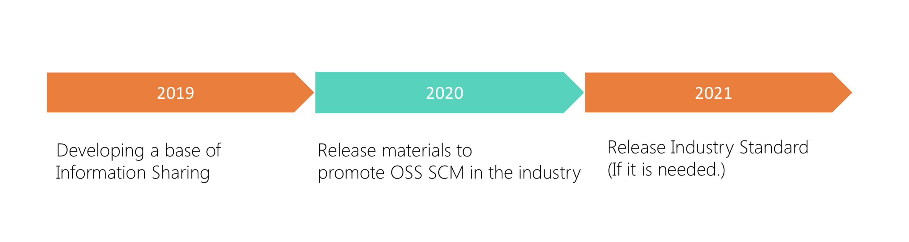
OpenChain in Automotive
Our expected outcome is that the OpenChain Standard, in the form of a formal ISO standard, will resolve automotive open source compliance concerns as effectively as other industries. However, OSS SCM may need a complementary standard to cover other topics.
Notes:
Our expected outcome is that the OpenChain Standard, in the form of a formal ISO standard, will resolve automotive open source compliance concerns as effectively as other industries. However, OSS SCM may need a complementary standard to cover other topics.

Slide 28
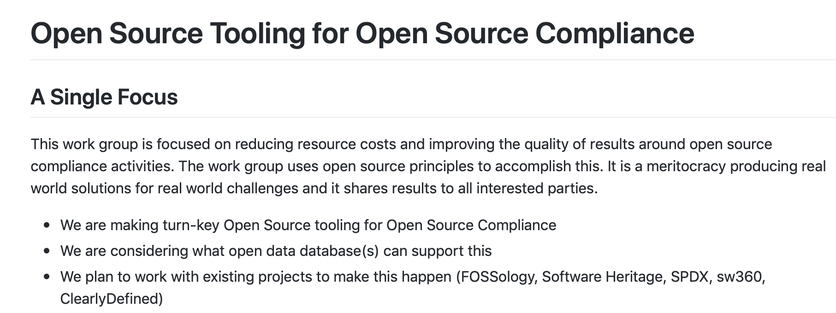
Overview of Project Status – Tooling Work Group
Siemens, Bosch, Toshiba, Fujitsu, Hitachi and more:
https://github.com/Open-Source-Compliance/Sharing-creates-value

Slide 29
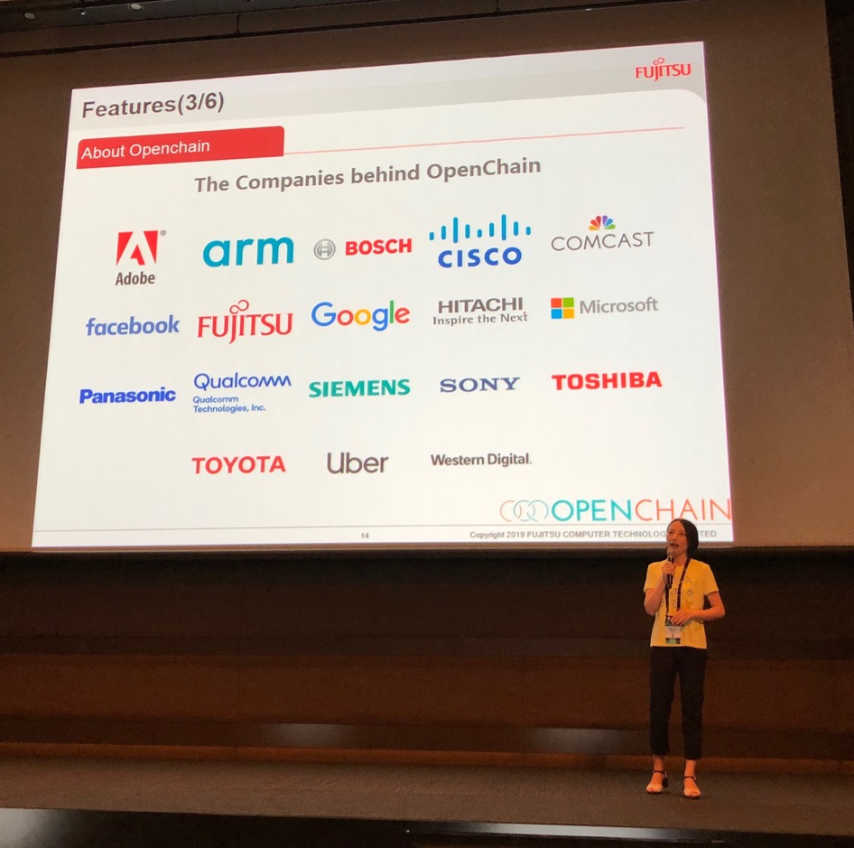
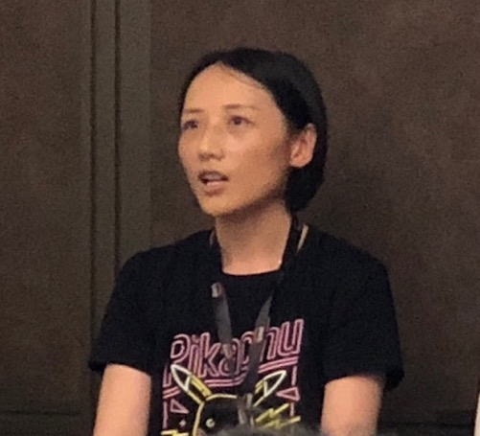
OpenChain in the Wild
Mingyu Wang @ Fujitsu China
Zephyr Talk
Notes:
We are beginning to feature in talks about other topics by non-OpenChain community members.

Slide 30
OpenChain: raising all the boats for the benefit of all.
Notes:
OpenChain is all about making everything more effective. A good concept to capture this is that we are raising all the boats, a process that will benefit all.

Slide 31
Be part of this
Join the community: https://www.openchainproject.org/community
Self-certify or Health Check an organization: https://certification.openchainproject.org
Notes:
You are invited to be part of this. You can join our community by visiting our website, subscribing to a mailing list, or hopping on one of our calls. You can also access the self-certification web-app and check how your current overarching processes map to international norms. Naturally that is completely private until you want to declare OpenChain Conformance.

Slide 32
coughlan@linux.com
Notes:
And that’s it. OpenChain is the standard that explains the key requirements of quality open source compliance programs. It is open, it has a vibrant community, and we want to work with you. Thank you so much for your time. Any questions?

